Slide 1
Uplifting the Farmer through a Connected Ecosystem
PIP2001 Capstone Project
Review-3
Batch Number: 38
Under the Supervision of,
Mr. Amarnath J.L
Assistant Professor
School of Computer Science and Engineering
Presidency University
Roll Number | Student Name
20211CSE0241 | G K Raghavendra Rao
20211CSE0243 | Bharath B Nagilla
20211CSE0246 | Jayanth D
20211CSE0336 | S Kushal
Name of the Program: CSE
Name of the HoD: Dr. Blessed Prince P/Dr. Robin Rohit/Dr.Asif Mohammed H.B
Name of the Program Project Coordinator: Mr. Amarnath J.L & Dr. Jayanthi. K.
Name of the School Project Coordinators: Dr. Sampath A K / Dr. Abdul Khadar A / Mr. Md Ziaur Rahman

Slide 2
Introduction
Agriculture has played a very vital role in the Indian economy, contributing about 17-20% and engaging around 50% of labour. Food security not only for the present 1.4 billion but also for those to come requires agriculture for sure. Farmers are the backbone of the agrarian Indian economy, provided their role as suppliers of food and raw materials.
Farmers in modern times face serious challenges that minimize their productivity and income. Most farmers have absolutely no access to markets where they can sell their crops. This leads to a lot of crop wastage, and for those who find markets, the prices are very low.
The main aim of our application is to provide an attribute-friendly mobile platform for farmers. This app was named 'AgriEase' and was designed to address most of the needs of a farmer thus bringing all aspects of the farming cycle on one available interface. AgriEase allows farmers to rent machinery, view up-to-date mandi prices, and seamlessly handle cart functionality with secure user authentication. The application does not need middlemen to facilitate the farmer in obtaining important information and performing transactions, both in farming activities and personal household expenses. AgriEase will also provide updated information about the availability of various government subsidies and grants. Farmers can therefore be totally empowered to enjoy full financial support from such schemes. AgriEase is a service-oriented facility that makes it easy for farmers to directly access agricultural credit and all support tools under one roof for maximum efficiency, complements, and maintains productive and good financial management.

Slide 3
Literature Review
The integration of technology into agriculture has garnered significant attention in recent years, primarily focusing on empowering smallholder farmers, who play a vital role in global food security. Mobile application is designed for better market access, information dissemination, and crop management, as well as solutions aimed at enhancing agricultural productivity through connected ecosystems.
Mobile applications are becoming increasingly vital tools in agriculture, offering innovative ways for farmers to manage crops, access market prices, and receive expert advice.
The goal is to bridge the gap between farmers and consumers, increase transparency, and ensure fair prices without the interference of middlemen.

Slide 4
Existing method Drawback
Difficulty in Machinery Access:
Farmers face challenges in locating machinery and renting farms, which can hinder productivity.
Report Generation Issues:
The current system struggles with producing accurate and timely reports, leading to inefficiencies in data management.
Limited Awareness:
Farmers' awareness of ecosystem services varies significantly, affecting their ability to utilize available resources effectively

Slide 5
Proposed Method
The proposed system will address the increasing demand for digital agriculture through offering a simple interface to farmers and any agricultural stakeholder. Major tab screens will include Crops, Machinery, Cart, and Profile, designed to afford users easy access to important tools and information. Excluding other features, the 'Crops' tab would be meant for viewing and managing data as far as crops are concerned, while the 'Machinery' tab is to be used for accessing farming equipment. The tab for 'Cart' would support e-commerce functionality regarding agricultural products, while the 'Profile' tab would make sure that the user has a personalized experience.
The backend architecture implements robust technologies in keeping operations very secure and reliable. The authentication routes are of vital importance during user validation at the time of registration and login. MongoDB is employed for managing the NoSQL database, ensuring flexibility and scalability in storing user information and operational data. Successful login will finally open a session by implementing token-based authentication mechanisms that ensure the accrued continuous access of users to their profiles and application features.
The proposed system implements a mechanism called UserContext to manage user data across the application. It ensures that any modification in the profile of a user would be changed dynamically over different screens, increasing the responsiveness and usability of the application. As the architecture of the system is modular, it can be easily scaled up in the future to include weather forecasting, crop disease diagnostics, and market price monitoring. This makes the solution flexible enough to support sustainable agricultural development.
It integrates several advanced backend technologies into an intuitive frontend interface, the objective of which is enabling agricultural efficiency in reducing human effort while equipping the users through informed decision-making. With secure authentication, dynamic data management, and ease of navigation, this turns the site into an appropriate application environment for target users such as small-scale farmers and large-scale agricultural enterprises

Slide 6
Objectives
Clean and user-friendly UI to help and facilitate farmers
Enhancing Farmer Access to Information
Increasing Technological Accessibility
Facilitating Knowledge Sharing and Collaboration
Providing Real-Time Problem Solving

Slide 7
Methodology/Modules
User Management Module:
Handles user registration, authentication, and role-based access control for farmers, aggregators, and general users.
Data Management Module:
Centralizes data storage for crops, machinery, loans, and fertilizers, ensuring easy access and report generation.
Reporting Module:
Generates reports on farming activities, financial transactions, and resource availability.
Awareness and Education Module:
Provides resources and information to educate users about ecosystem services and best farming practices.

Slide 8
Architecture
Modular Architecture: Divides functionality into components like ToolsGrid, CropsGrid, ToolDetail, etc.
Navigation-Driven: User flow is managed by React Navigation.
Data Handling:Tools and Crops are stored in toolsData and cropsData.Data is passed via props between components for consistency.

Slide 9
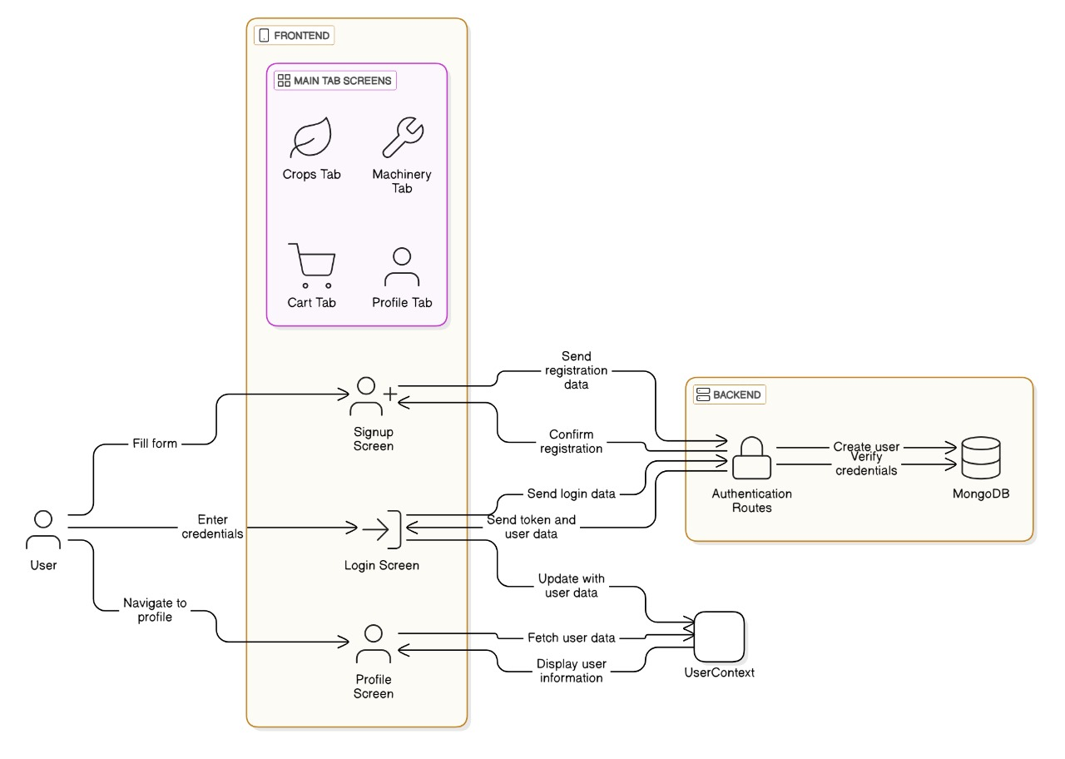
Architecture Diagram

Slide 10
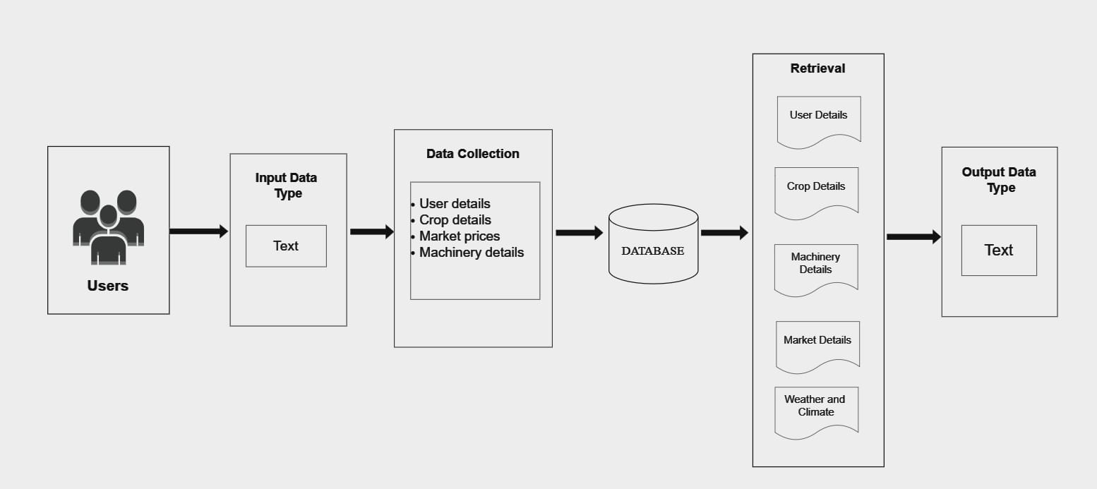
Flow-Diagram

Slide 11
Hardware/software components
Hardware Components
Servers: For hosting the application and database.
User Devices: Smartphones, tablets, or computers for accessing the application.
Software Components
Frontend: React Native: For building the mobile application.
Backend: Node.js: For server-side logic and API management.
Database: MongoDB for data storage.
Development Tools: Visual Studio Code: A lightweight IDE for code editing with support for various extensions.

Slide 12
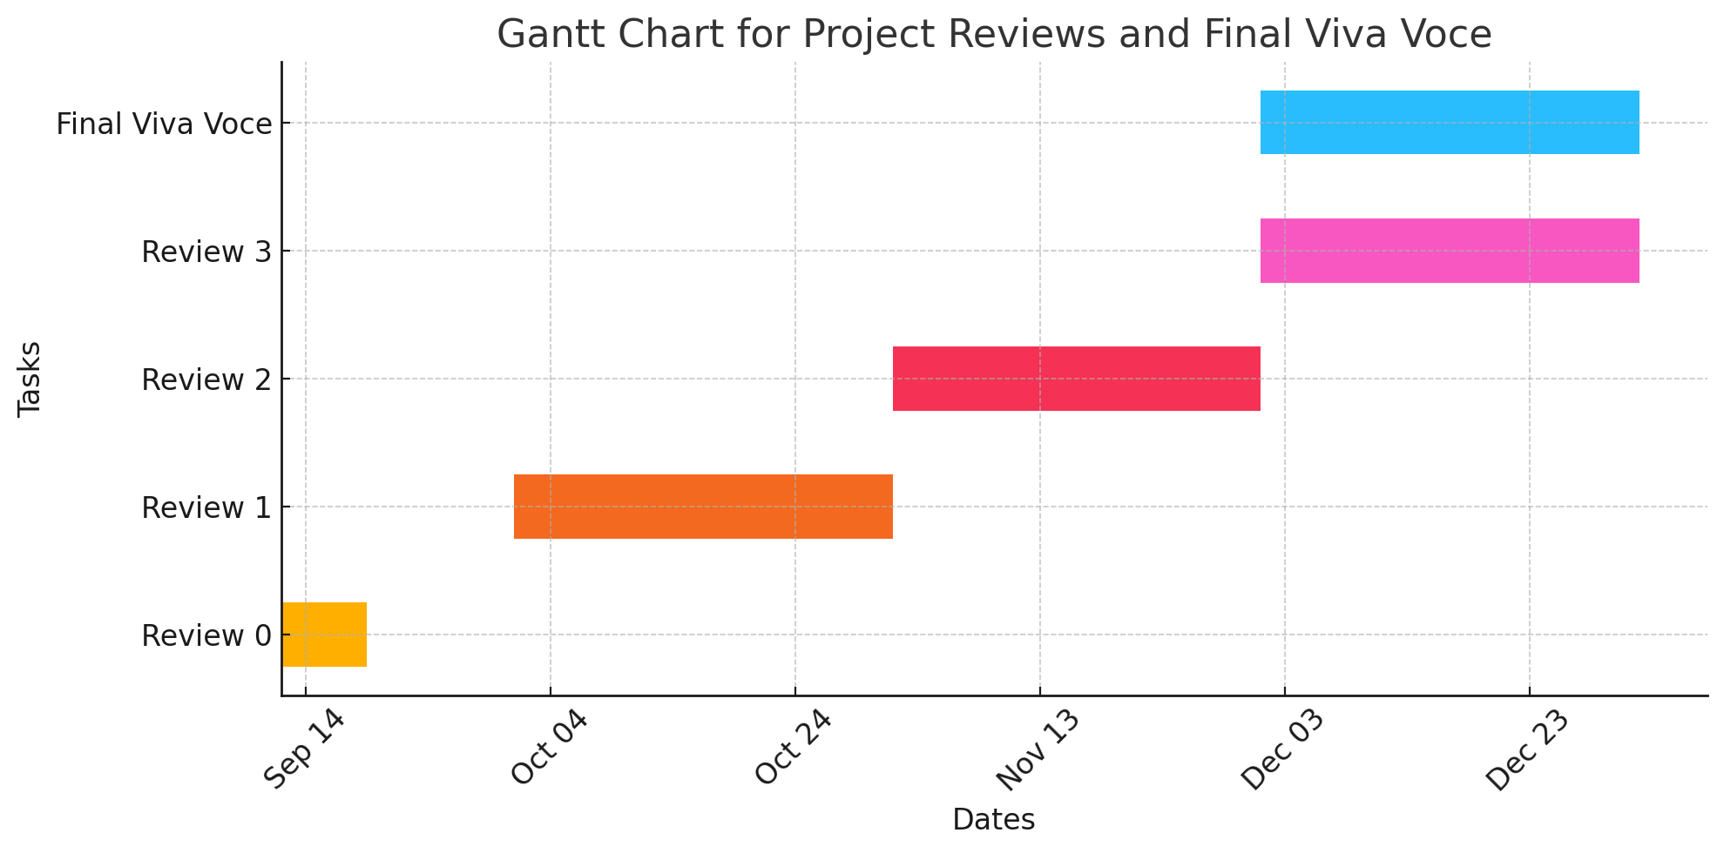
Timeline of Project

Slide 13
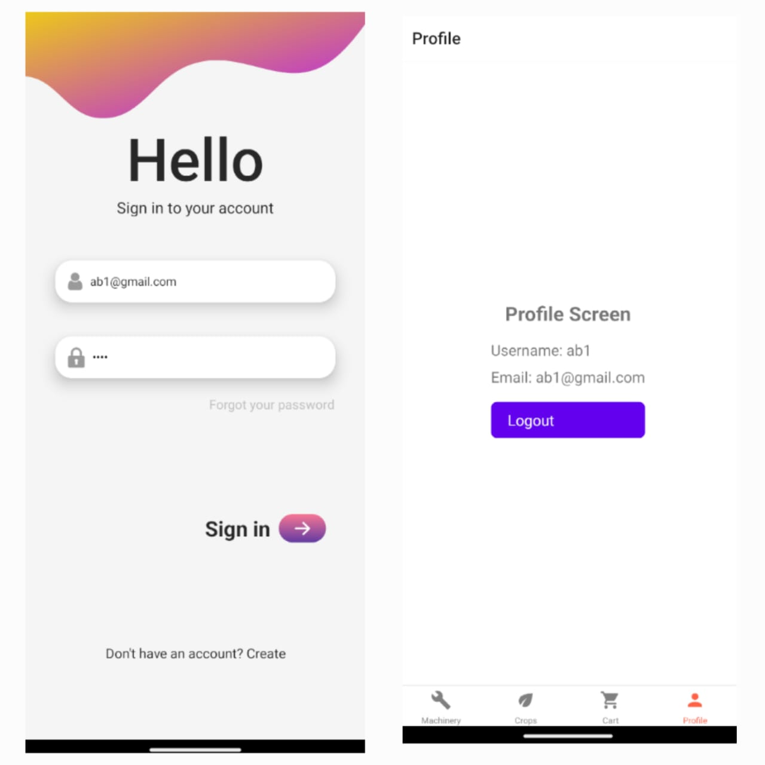
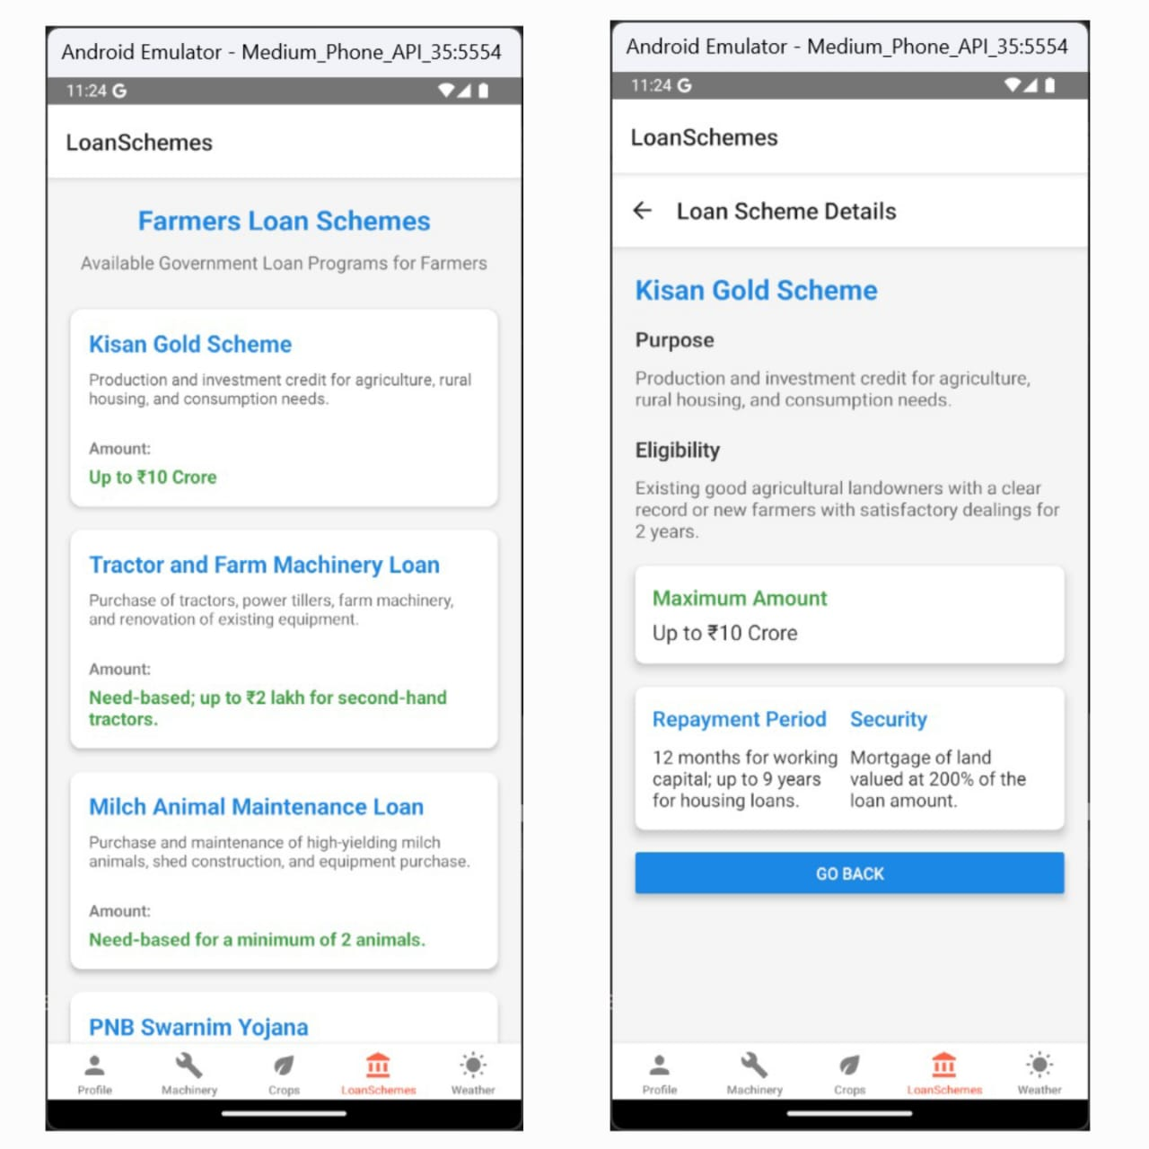
Outcomes

Slide 14
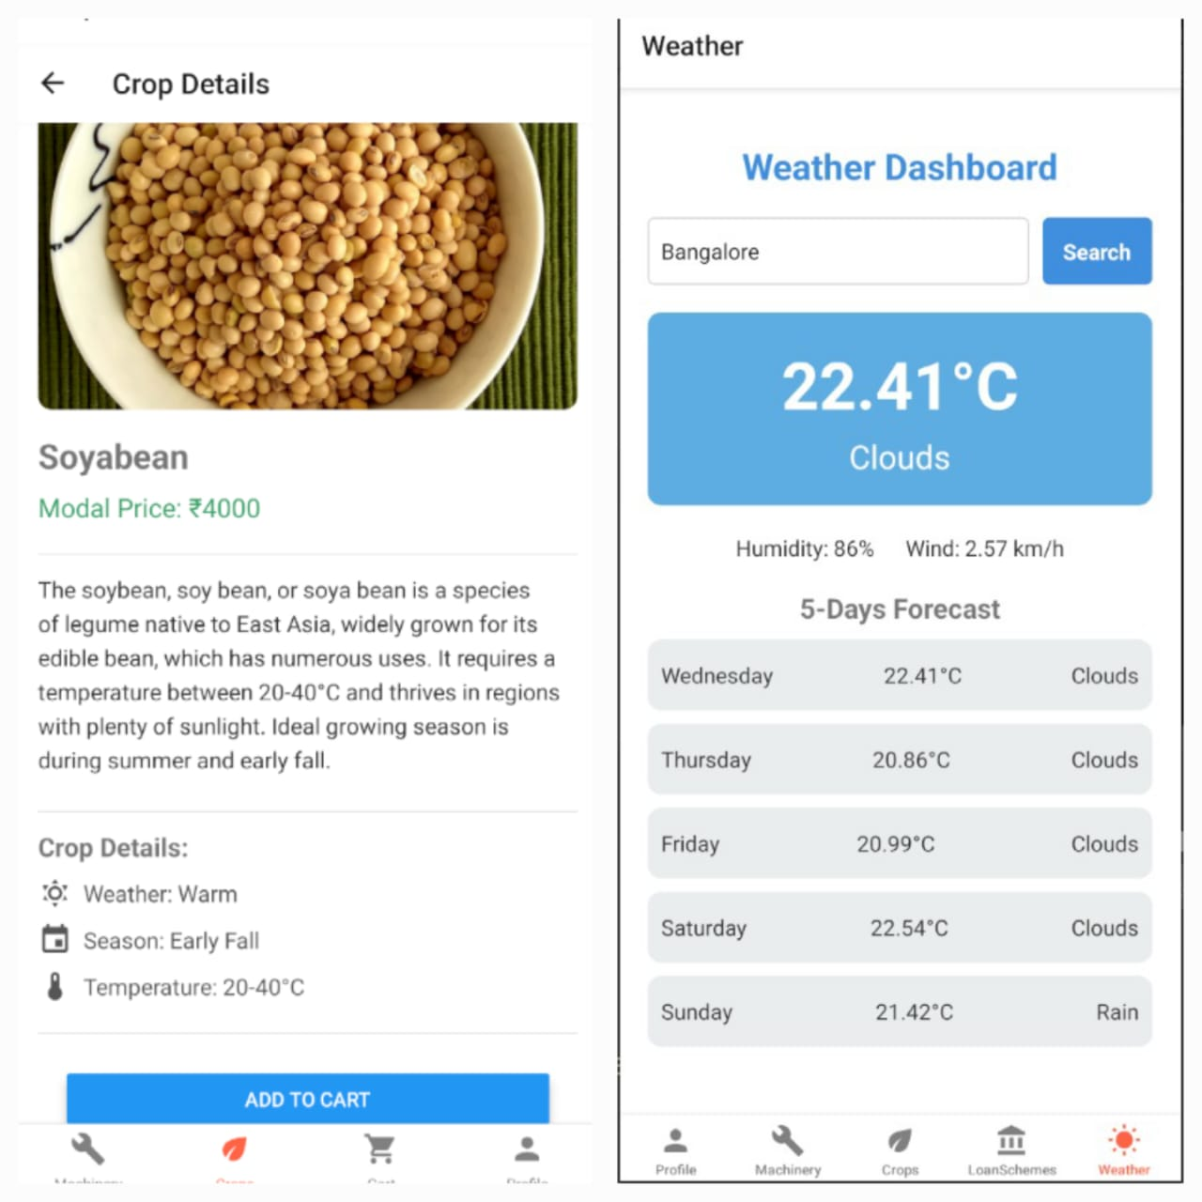
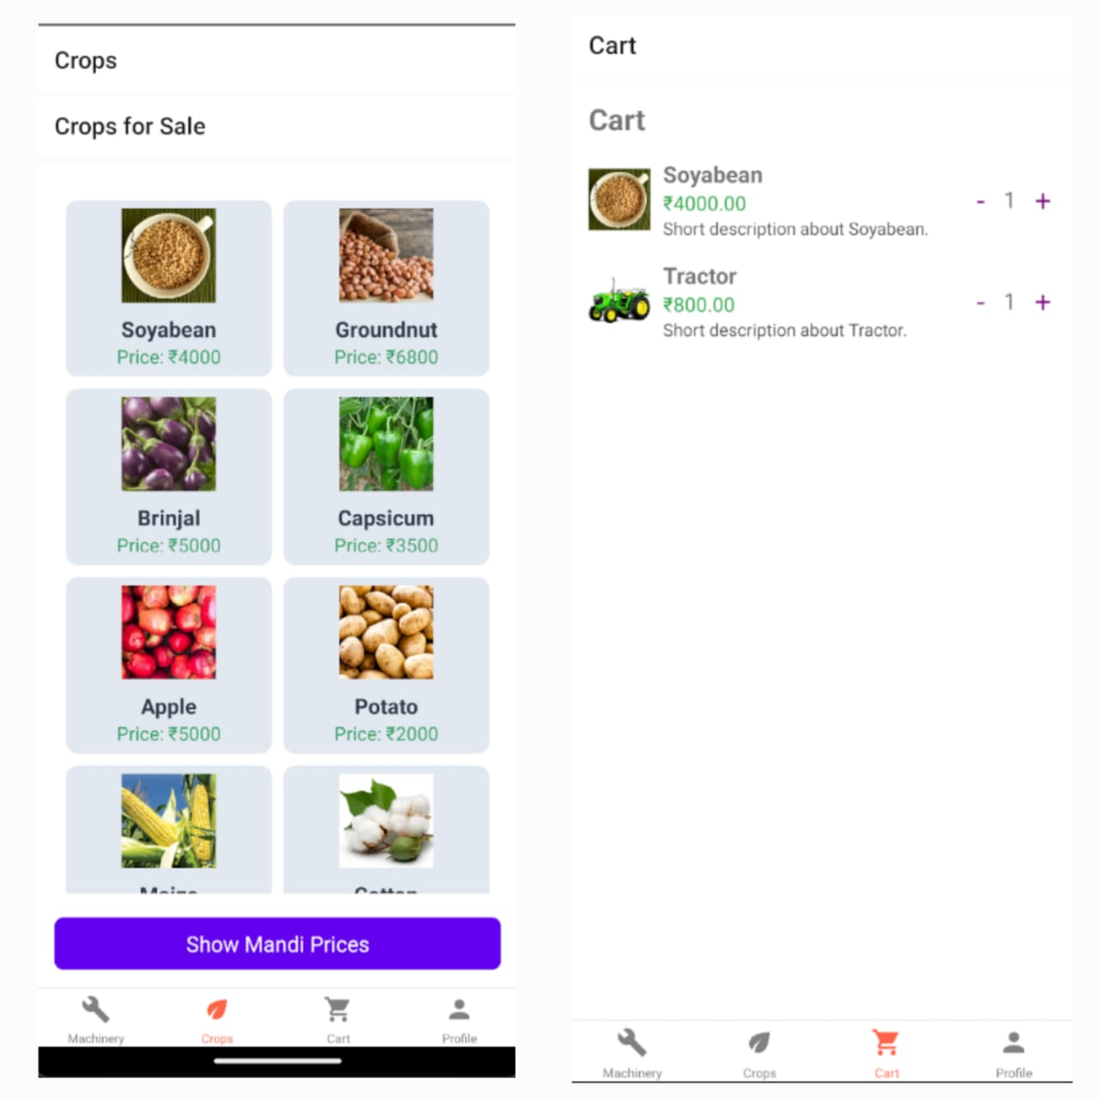
Outcomes

Slide 15
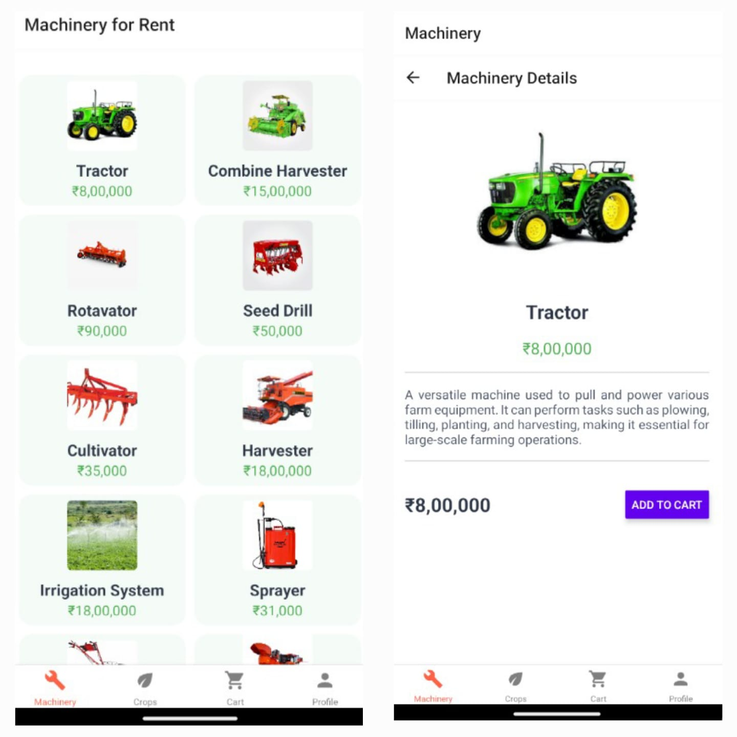
Outcomes

Slide 16
Conclusion
A mobile app designed for farmers can provide numerous benefits, significantly improving agricultural productivity, sustainability, and income generation. Here’s a conclusion on how such an app can help farmers in agriculture:
The application will go all the way to the servers, enabling farmers to feel safe with the User Authentication Module, to access machinery efficiently via the Machinery Marketplace Module, to sell crops in a straightforward way through the Crop Selling Module, and to make farming decisions based on data thanks to the Weather Insights Module.
In summary, a mobile app designed for agriculture can revolutionize farming by empowering farmers with the tools and knowledge they need to enhance productivity, increase income, and build more resilient agricultural practices.

Slide 17
Github Link
The Github link provided should have public access permission.
https://github.com/Bharathnags/UPLIFTING-THE-FARMER-THROUGH-CONNECTED-ECOSYSTEMS

Slide 18
References
M. Masinde and P. N. Thothela, "ITIKI Plus: A Mobile Based Application for Integrating Indigenous Knowledge and Scientific Agro-Climate Decision Support for Africa’s Small-Scale Farmers," 2019 IEEE 2nd International Conference on Information and Computer Technologies (ICICT), Kahului, HI, USA, 2019.
J. Jayachitra, M. Madhu and S. D. S. Mohammed Faruk, "AGRI SUCCOR: Mobile Application for Agriculture," 2019 International Conference on Communication and Electronics Systems (ICCES), Coimbatore, India, 2019.
N. Nojozi, M. S. Scott and P. Nomnga, "An m-agric application for broadcasting agricultural information for subsistence farmers in rural areas of the eastern cape," 2016 IST-Africa Week Conference, Durban, South Africa, 2016.
D. S. Gangwar, S. Tyagi and S. K. Soni, "Connecting Farmers to Knowledge, Networks and Institutions for Agroecological Sustainability," 2020 International Conference on Electrical and Electronics Engineering (ICE3), Gorakhpur, India, 2020.
U. Patii, P. Saxena and N. Sidnal, "Peer-to-peer knowledge sharing platform for farmers with auto-recommendation feature," 2017 International Conference On Smart Technologies For Smart Nation (SmartTechCon), Bengaluru, India, 2017.
N. Kuntagod, S. Paul, S. Kumaresan, S. Ganti and G. Yala, "Last-mile wireless connected crop solution for smallholder farmers: Profitably connecting all the major players in the agriculture ecosystem in rural areas," 2015 IEEE Asia Pacific Conference on Wireless and Mobile (APWiMob), Bandung, Indonesia, 2015

Slide 19
References
J. Kundu, S. Debi, S. Ahmed and S. Halder, "Smart e-agriculture monitoring system: Case study of Bangladesh," 2017 4th International Conference on Advances in Electrical Engineering (ICAEE), Dhaka, Bangladesh, 2017.
R. Pavithra., C. Padmavathy., S. Vijayalakshmi and N. Nandhine Shree., "Farm Book: An Interactive Mobile Application for Smart Farming," 2023 International Conference on Inventive Computation Technologies (ICICT), Lalitpur, Nepal, 2023.
N. Mittal and A. Kumar, "App Based Implementation of Modern Agriculture Utilities for Farmers," 2023 4th International Conference on Intelligent Engineering and Management (ICIEM), London, United Kingdom, 2023.
P. Shriram and S. Mhamane, "Android App to Connect Farmers to Retailers and Food Processing Industry," 2018 3rd International Conference on Inventive Computation Technologies (ICICT), Coimbatore, India, 2018.
T. Yadav, P. Sable and D. Kalbande, "SMART KISAN: A Mobile App for Farmers' Assistance in Agricultural Activities," 2023 International Conference on Smart Systems for applications in Electrical Sciences (ICSSES), Tumakuru, India, 2023.
H. V. Abhijith, D. A. Jain and U. A. Athreya Rao, “Intelligent agriculture mechanism using internet of things,” 2017 International Conference on Advances in Computing, Communications and Informatics (ICACCI), 2017, pp. 2185-2188, doi: 10.1109/ ICACCI.2017.8126169.
B. Ranjitha, M. N. Nikhitha, K. Aruna, Afreen and B. T. V. Murthy, “Solar Powered Autonomous Multipurpose Agricultural Robot Using Bluetooth/Android App,” 2019 3rd International conference on Electronics, Communication and Aerospace Technology (ICECA), 2019, pp. 872-877, doi: 10.1109/ICECA.2019.8821919.
M. W. Aktar, D. Sengupta, & A. Chowdhury, “Impact of Pesticides Use in Agriculture: Their Benefits and Hazards,” Interdisciplinary toxicology. 2. 1-12. 10.2478/v10102-009 0001-7.
A. A. Al-Zaidi, E. A. Elhag, S. H. Al-Otaibi and M. B. Baig, “Negative effects of pesticides on the environment and the farmers awareness in Saudi Arabia: A case study,” Journal of Animal and Plant Sciences 21, no. 3 (2011): 605-611. [20] Q. Lian , F. Tan, X. Fu, P. Zhang, X. Liu and W. Zhang, “Design of precision variable rate spray system for unmanned aerial vehicle using automatic control method,” International Journal of Agricultural and Biological Engineering, 12(2), pp.29-35.

Slide 20
Thank You

